Slide 1

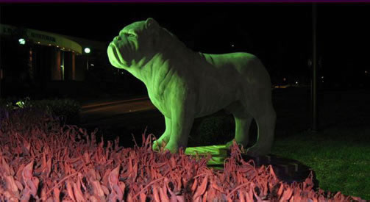
South Carolina State University
Division of Economic Research and
Economic Development
Notes:
James E. Clyburn University Transportation Center

Slide 2

ENVIRONMENTAL POLICY INSTITUTE
NNSA TECHNICAL MEETING
Norfolk State UNIVERSITY
Norfolk, Virginia
November 9th & 10th , 2010

Slide 3
Environmental Policy Institute’s
Project Title
The Enhancement of Research,
Environmental Management, and Science
Curriculum through the Environmental Policy
Institute at South Carolina State University.

Slide 4
OBJECTIVE
The Goals and Objectives are to support the strategic mission and goals of the NNSA; to enhance SCSU’s program of applied research, policy analysis; and to assist the NNSA in cultivating the next generation of national security science and technology leaders by preparing another generation of nuclear trained professionals to enter the workforce.

Slide 5
ENVIRONMENTAL POLICY PROGRAMS
Research
Curriculum Development
NNSA Summer Internship
Scholarships
Outreach and Training

Slide 6
RESEARCH
Massie Chair- Conduct research in the area of Computational Fluid Dynamics with Thermal Dynamics, Thermal Hydraulics
Research/Study - South Carolina’s Role in Nuclear Infrastructure Security
Research and Evaluation of Radioisotope sources in South Carolina
Current regulations on radwaste containers, designs & certifications
.

Slide 7
SCHOLARSHIPS
SCSU’s Nuclear Engineering Program focus is to produce minority nuclear engineers.
Students receive financial support through the EPI scholarship program.
Nine (9) graduates to date
53 students enrolled – 19 Females 34 Males
August 2008- received ABET-EAC accreditation

Slide 8
CURRICULUM DEVELOPMENT
Radiochemistry Program- Initiated in 2005, EPI funds used in hiring of faculty, equipment, and media resources
Radio Chemistry - Five graduates
(all minority females)
May 2011 Graduation- 1 student

Slide 9
NNSA SUMMER INTERNSHIP
Marketing campaign, recruitment, interviews, and planning
NNSA Laboratories: Los Alamos Site, Los Alamos, New Mexico; Savannah River National Laboratory, Aiken, South Carolina; Washington, DC
Participants: Ten (10) Students- Summer 2010

Slide 10
NATIONAL CONFERENCE
Securing Our Future: Using New Technology to Reduce America’s Dependence on Foreign Oil- June 15-18, 2011
Water: Critical Issues Facing the Future of Our Essential Natural Resource
Conquering Climate Change: New Opportunities, New Economics (Keynote Speaker, Mr. Jim Rogers, CEO, Duke Energy)

Slide 11
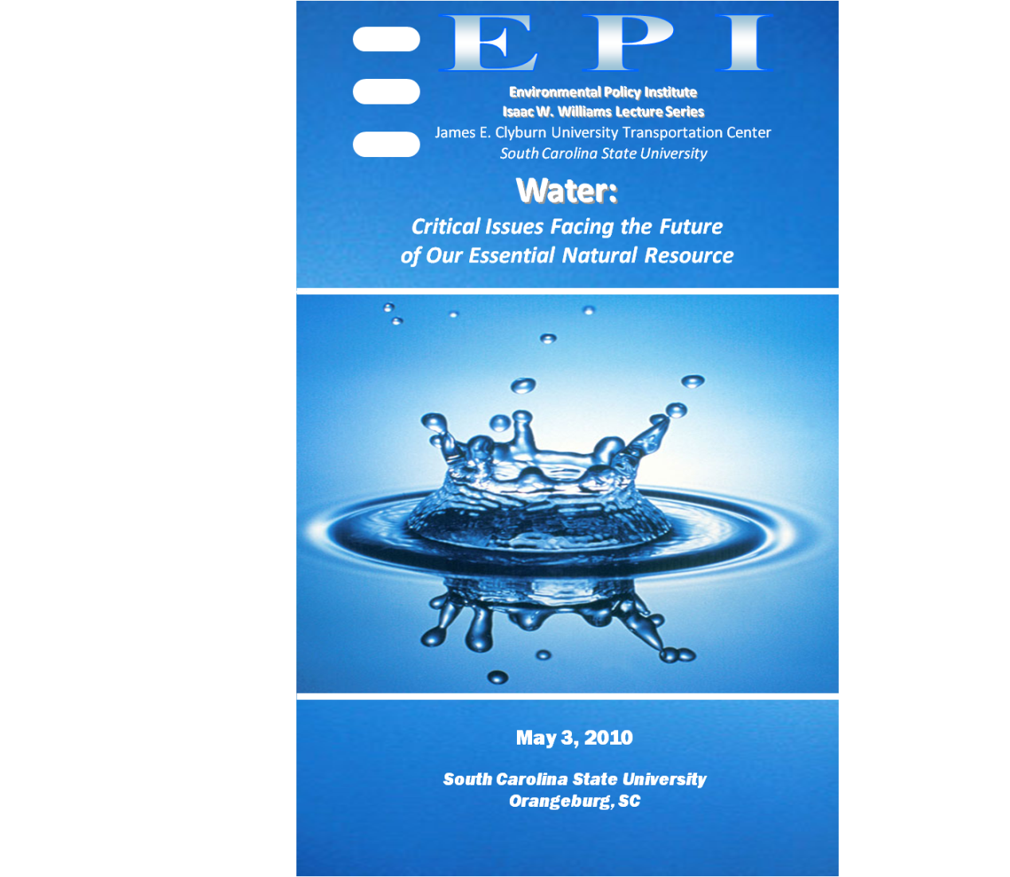
Water: Critical Issues Facing the Future of Our Essential Natural Resource – 2010 Conference

Slide 12
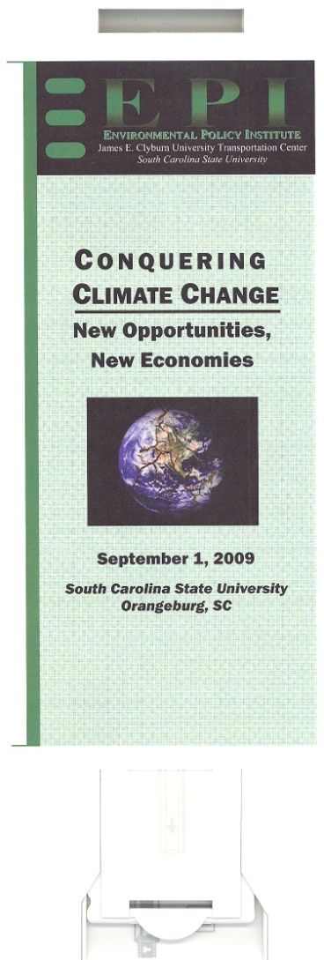
Conquering Climate Change - 2009 Conference

Slide 13
OUTREACH
Made for Television Dialogue- DVD- “The Nuclear Alternative” – Length 56:46
Technical Assistance Workshops & Community Leaders Institute :
Albuquerque, New Mexico
Charleston, SC
Aiken, SC
Bamberg, SC
Denmark, SC
Hemingway, SC
Augusta, Georgia
Barnwell, SC
Johns Island, SC
Phoenix, Arizona – TBA 2011

Slide 14
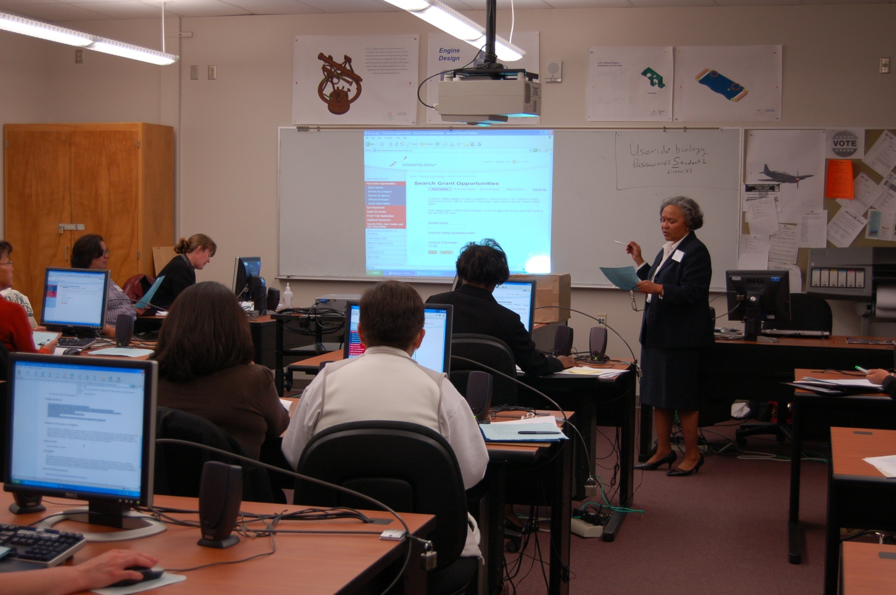
Technical Assistance Workshop

Slide 15
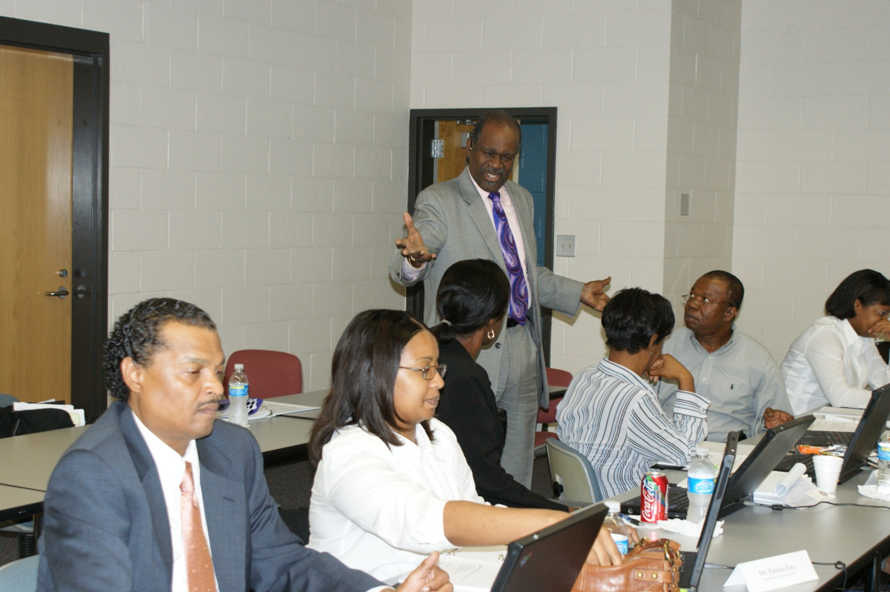
Faculty/Staff Professional Development Institute
Notes:
A one-week (7 days) Institute that delivers hands-on, intensive training to five (5) select researchers from the College of Science, Mathematics, and Engineering Technology (SMET) in the preparation of proposals relevant to the mission of NNSA and DOE. The goals is to also enhance sponsored programs infrastructure at SCSU through the employment of a grant/proposal writer that will result in an increased number and quality of proposals submitted to NNSA and Doe related research.

